Slide 1
Technology Review
D-Tracer
Noelle Reimers, Chau Vuong,
Ryan Ostrander, Alyson Shoji

Slide 2
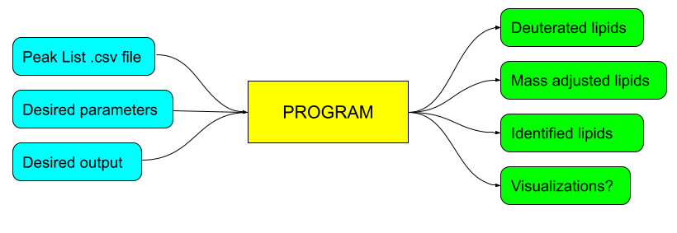
Background: D-Tracer
Our tool takes mass spectrometry lipidomic data in the form of a peak list and returns a list of deuterated lipids or other output files.
Intended user has no coding experience
Need a user-friendly interface

Slide 3



What technologies you considered?
Various web app tools to display content and create a user interface
Streamlit
Straightforward and user friendly
Plotly
Flexible and mature plotting tool
Kivy
Cross-platform versatility for use in a wide variety of applications including mobile apps

Slide 4
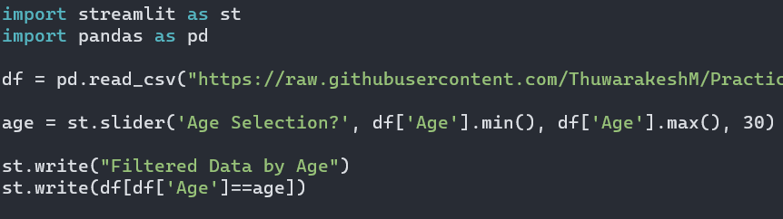
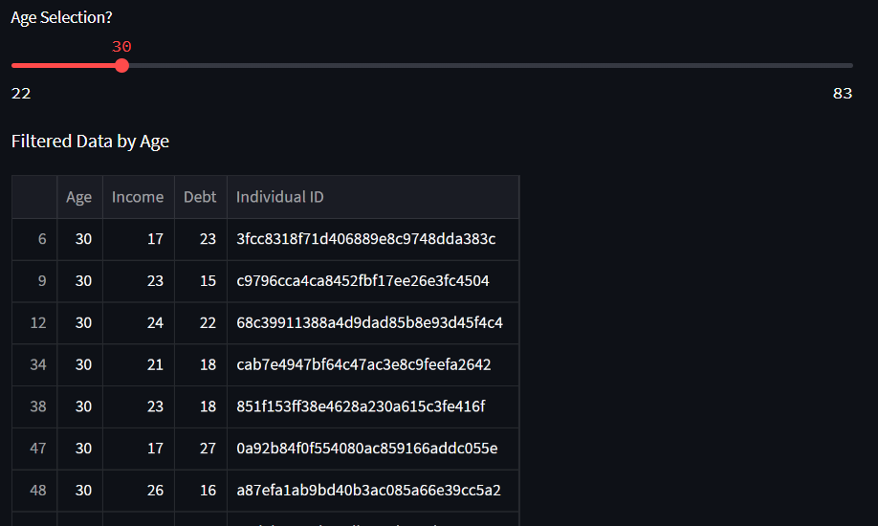
Choice: Streamlit
Summary
Import streamlit library
Use simple commands in python
st.line_graph, st.slider, etc.
Run the code straight from the terminal
streamlit run file.py
Produces URL where the web app can be accessed
Live options with widgets to alter parameters
dropdowns, file uploaders, etc.
Can deploy app with unique URL
Notes:
Ryan

Slide 5
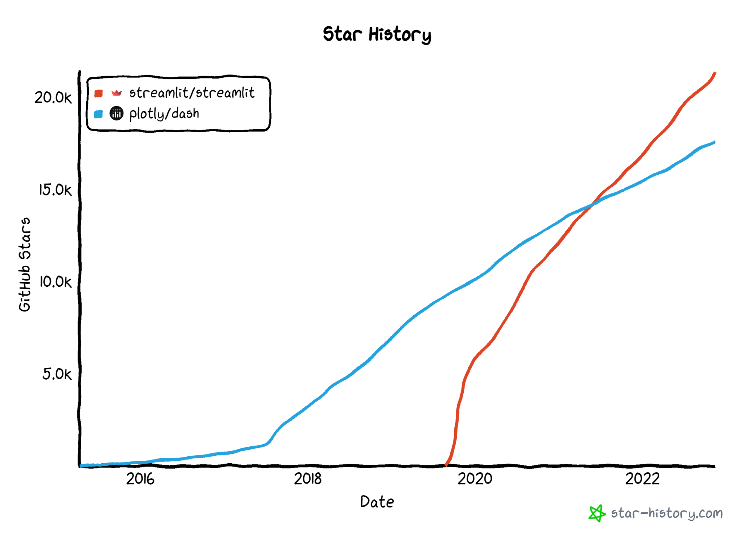
Appeal of Choice
Low learning curve
Simplicity
Short coding script with linear flow
Minimal prerequisite skills required
Compatible with major libraries & framework
Altair, Bokeh, Seaborn, Pandas, etc.
Well-documented
Default stylesheet

Slide 6
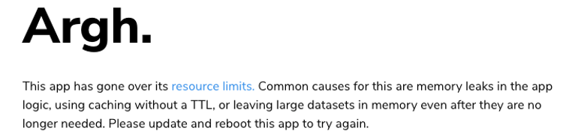
Drawbacks of Choice
Only support Python programming language
Speed issues
The entire script has to be re-run when an input is changed
Crash problems with large dataset
Dataframe size greater than 200MB
Does not support Jupyter notebook
Works directly with Python script files

